Slide 1
Brian Cornet DSC 498 Dr. Donghui Yan Final Capstone Presentation
December 2nd, 2020

Slide 2
Part 1:
Bri comes up with a bunch of ideas

Slide 3
Initial Proposals
Quantum Tech. Survey
Raw Image Scanner
MIPS Decompiler
Rules Analyst
Socialization Helper
Help-A-Professor
Resources and Challenges

Slide 4
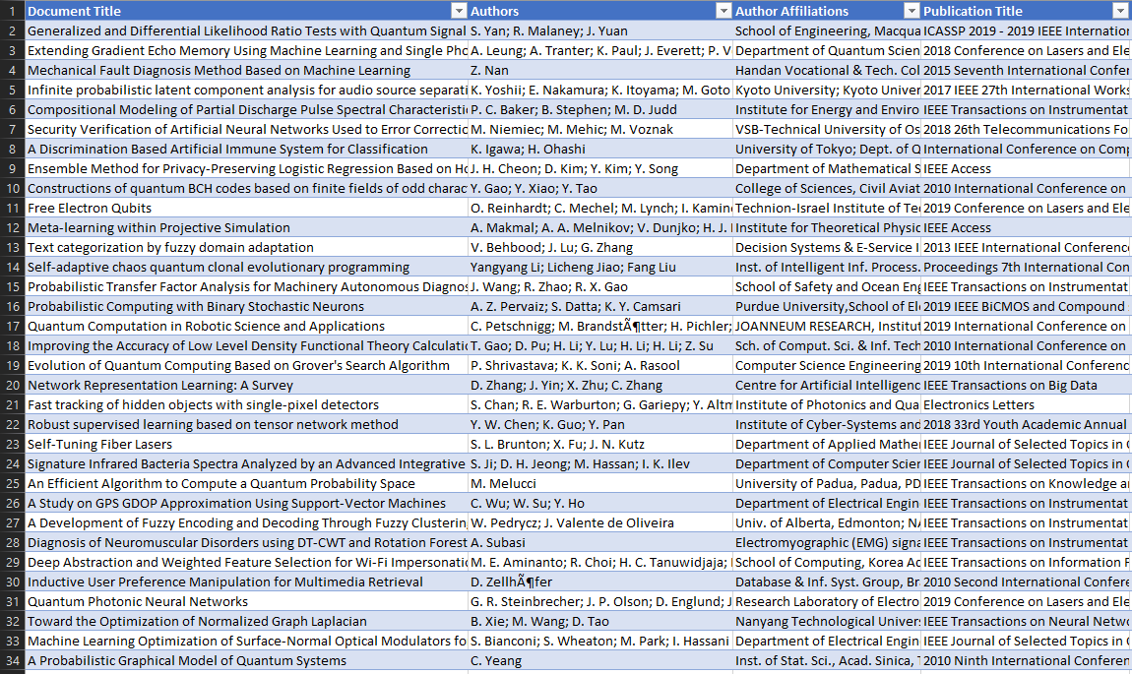
Quantum Tech. Survey
Collect details on published research on quantum technologies (IEEE, commercial, etc.)
Harmonize data set for analysis: contributors, dates, tags, etc.
Determine high-focus areas based on time, region, methods, impact factor, industry

Slide 5
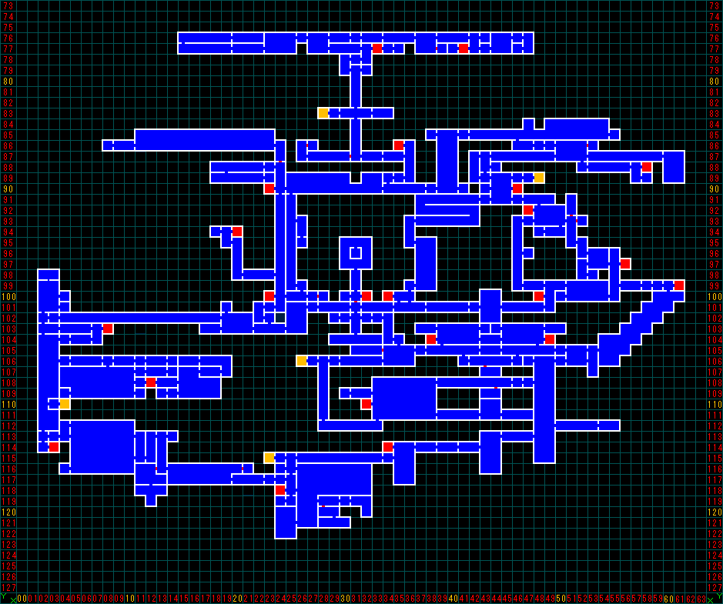
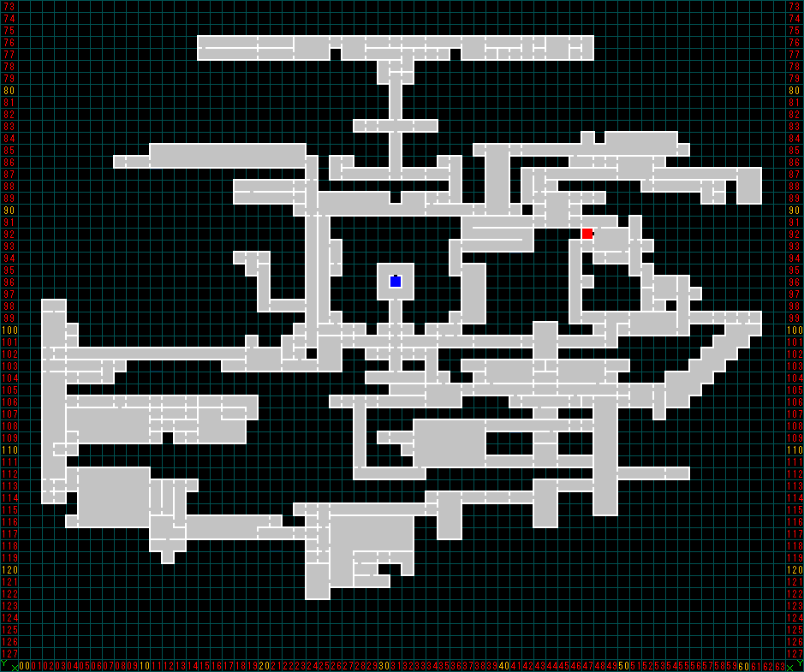
Raw Image Scanner
Create system that accepts an image as a template and compares it to a camera image
Include generating text lists or tables, filling templates, or highlighting differences
Provide image correction for flawed camera images

Slide 6
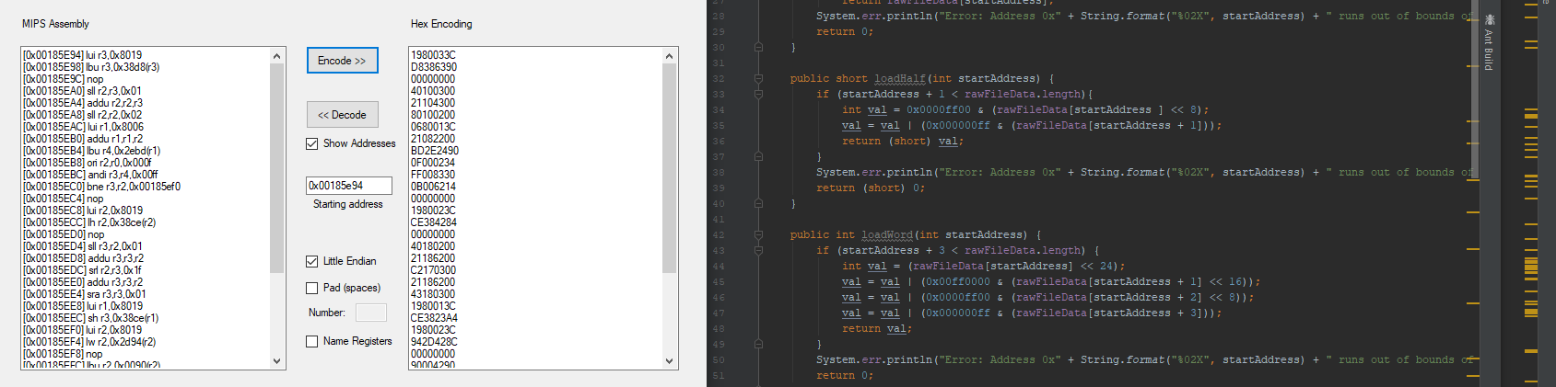
MIPS Decompiler
Convert MIPS Assembly language code into popular modern languages
Revert decompiled or modified code back into MIPS Assembly
Examine compatibility with use on modern hardware

Slide 7
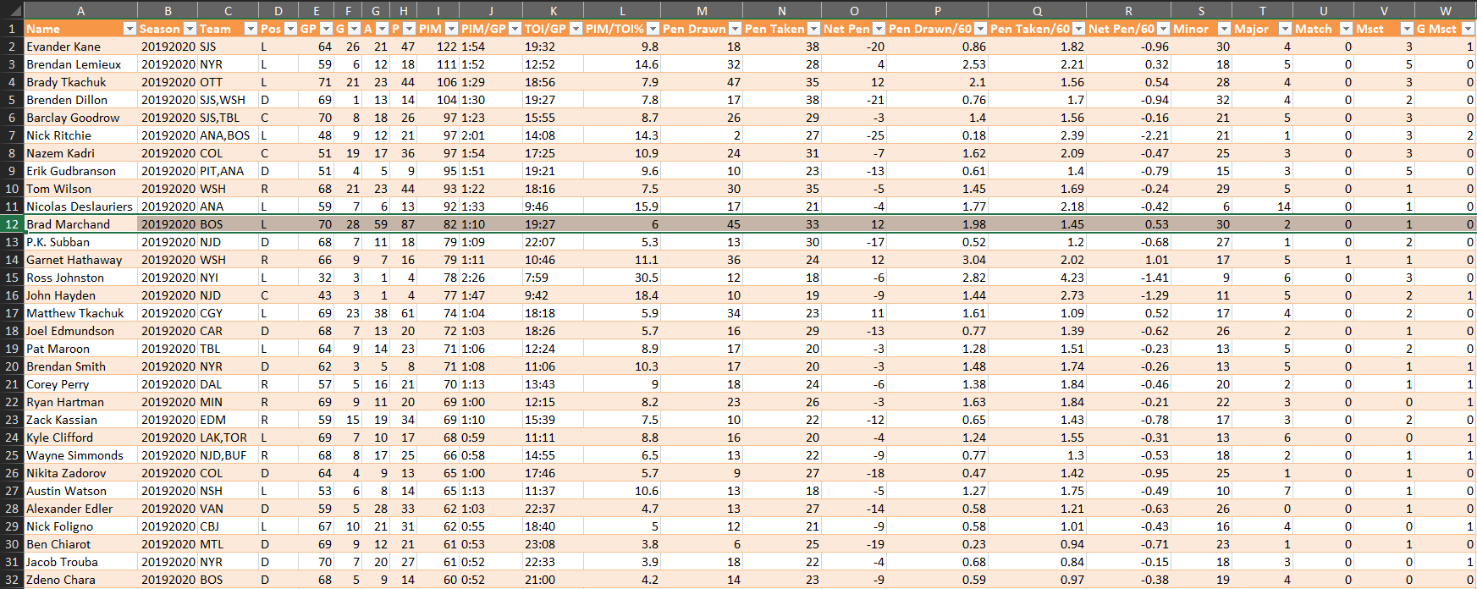
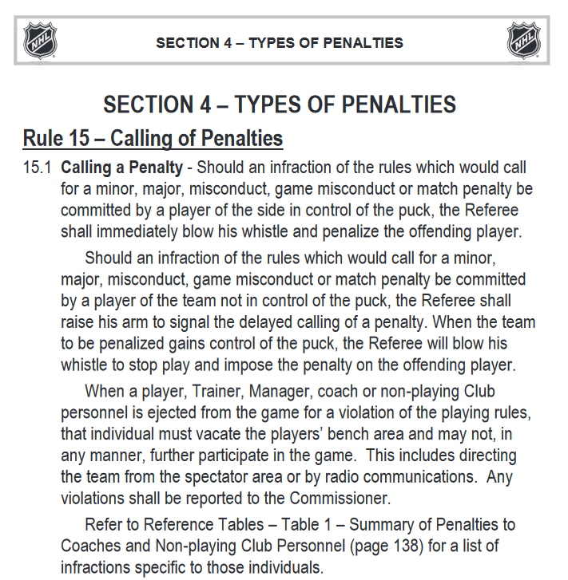
Rules Analyst
Interpret rulesets of various sports or games from source rulebooks through text parsing
Create model for ML using supervised/unsupervised learning
Determine impact of rule changes in style of professional-level play

Slide 8
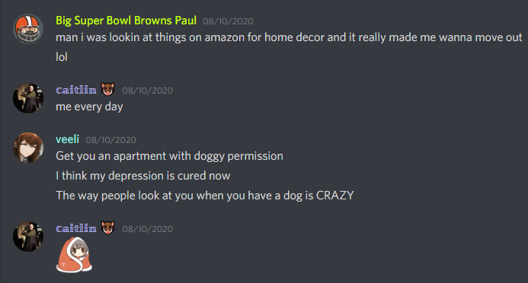
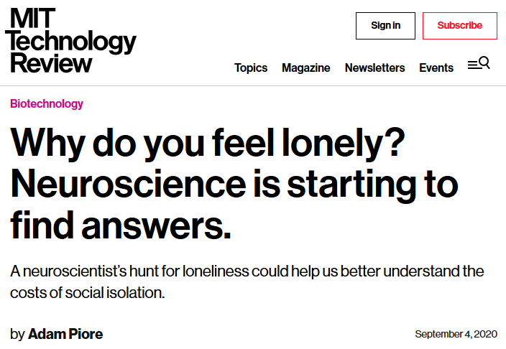
Socialization Helper
Create platform to encourage online interaction among friends/family
Analyze usage habits to help users deal with loneliness and depression
Devise security and privacy methods to deter improper use

Slide 9
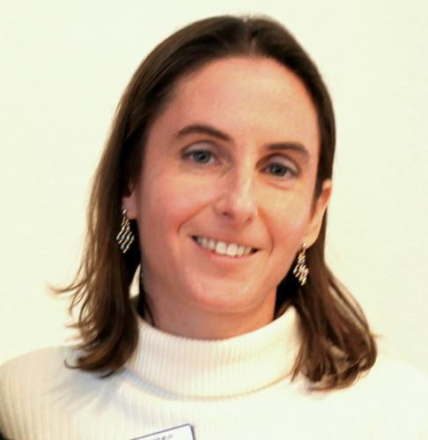

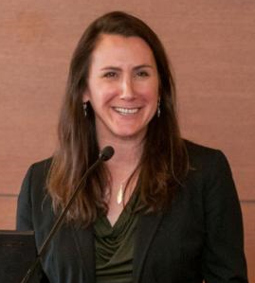
Help-A-Professor
Dean of CAS Prof. Pauline Entin and Prof. Shannon Jenkins:
Comparing online vs. in-person learning methods
Prof. Keivan Sadeghzadeh:
“Predictive Models for Preventable Readmission for Mental Patients Using Socioeconomic Disadvantages” [Ongoing Project]
“Detecting and Predicting Medical Errors in Cancer Screening Process” [New Project]
“Mental Health Service Supply and Demand in the Post-Pandemic Healthcare” [New Project]
Entin (top-left);
Jenkins (bottom-left);
Sadeghzadeh (right).

Slide 10
Resources and Challenges
Resources:
HTML parsing for web data, Optical Character Recognition (OCR)
R, MATLAB, Python, Java, C++, SQL, Assembly language tools as needed
Viewers like you!
Challenges:
Machine learning methods in Spring 2021
Artificial intelligence methods TBA
Physical limitations during pandemic

Slide 11
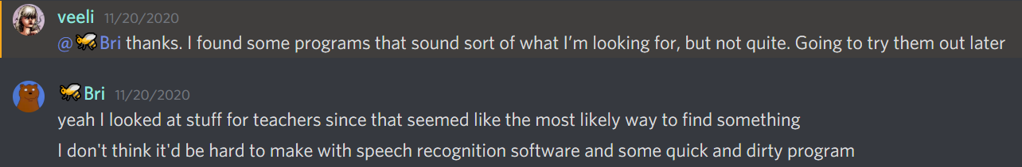
What could have been:

Slide 12
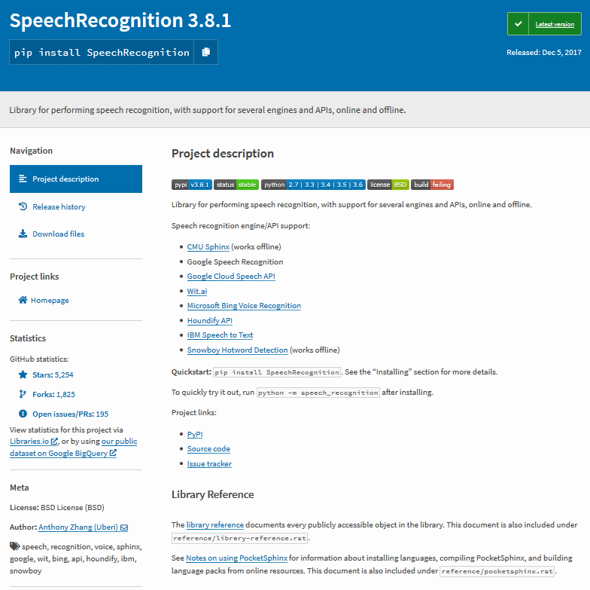
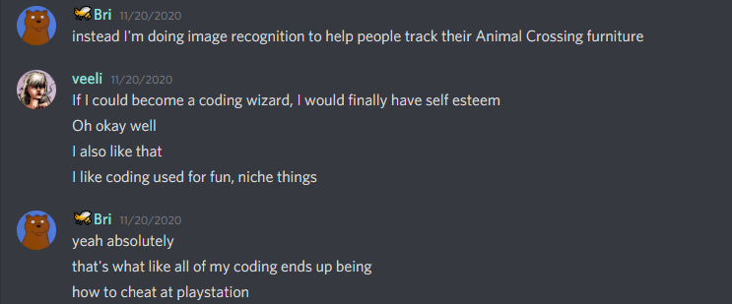
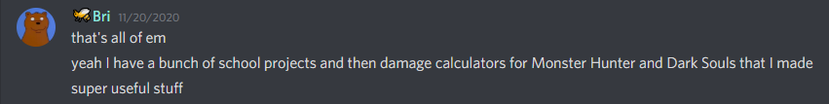
What could have been:
(I still wanna do this)

Slide 13
Part 2:
Bri goes with the Raw Image Scanner idea

Slide 14
Raw Image Scanner – Outline
Objectives:
Create system that accepts an image as a template and compares it to a camera image
Include generating text lists or tables, filling templates, or highlighting differences
Implement image correction for flawed camera images (skewing, reflection, warping, etc.)
Tools:
Optical Character Recognition (OCR) using libraries such as PyTesseract
Image comparison algorithms for image blocks using libraries such as PyImageSearch
Decoding algorithms for various formats (JPEG, GIF, PNG, TIF, AVI, MPEG, MP4, MOV, WEBM, etc.)
Challenges:
No formal machine learning courses until Spring 2021 (for image correction)
Physical limitations during pandemic (for experimentation)

Slide 15
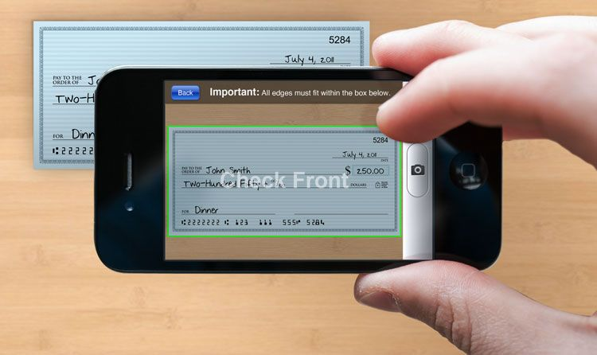
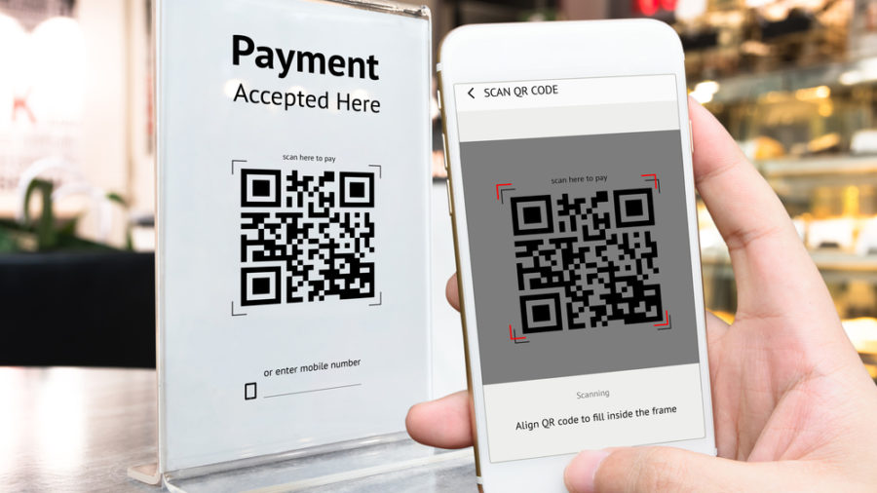
Raw Image Scanner – Concept
Comparable to commonly used technology for scanning checks, license plates, QR
Typically for specific patterns or professional usage

Slide 16
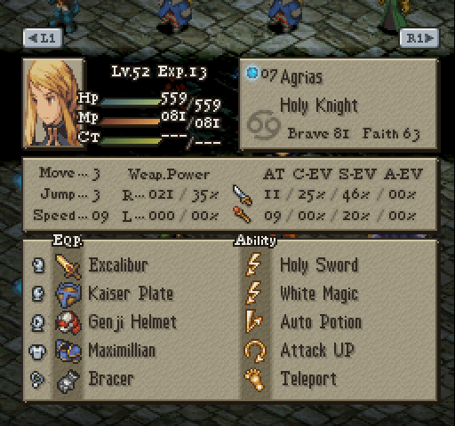
Raw Image Scanner – Design
Intended for users to collect any kind of data quickly and automatically
Ideal for when digital data doesn’t exist or can’t be easily accessed
The image for the character on the right contains 36 variables.
Without a means of accessing the raw data, a human would need to compile the visible data by hand (takes about 2-3 minutes).
What if a computer could recognize the values formed by the pixels?
Final Fantasy Tactics (Sony PlayStation)

Slide 17
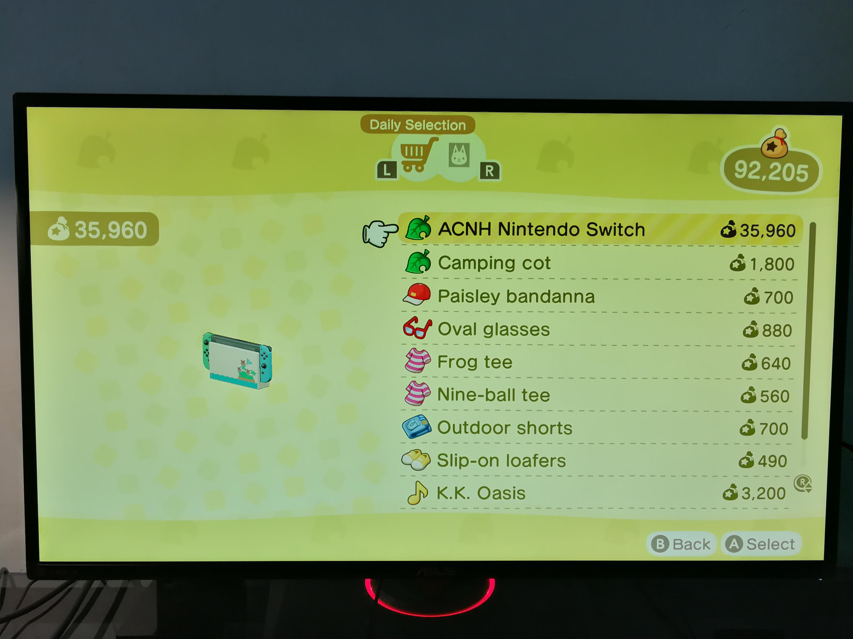
Example – Text Parsing Lists
The user inputs a screenshot containing a simple list.
The text is parsed and added to a list. New items may be added to the same list, and it may be saved or exported as needed.
* This screenshot has much more text than what was collected. It may be necessary for the user to determine a pattern to the collection process.
ACNH Nintendo Switch
Camping cot
Paisley bandanna
Oval glasses
Frog tee
Nine-ball tee
Outdoor shorts
Slip-on loafers
K.K. Oasis
Animal Crossing: New Horizons (Nintendo Switch)

Slide 18
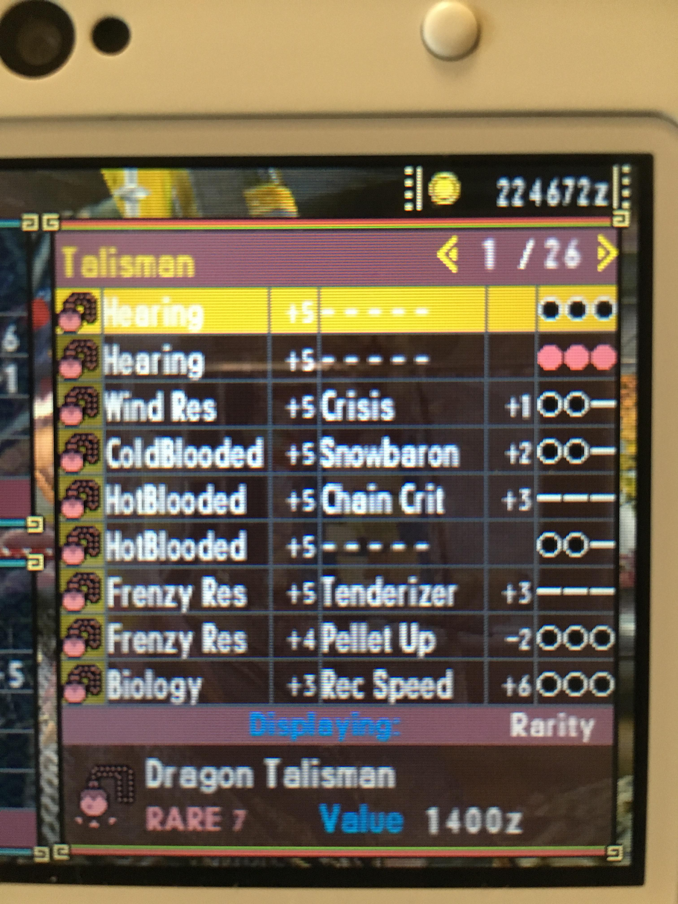
Example – Text Parsing Tables
The user inputs a screenshot containing a table.
The text is parsed and added to a table. New items may be added to the same table, and it may be saved or exported as needed.
* The top line is difficult to read, and the second line has different colors for its 5th column. Visual differences may require the user to define their importance.
Hearing | +5 | – – – – – |  | OOO
Hearing | +5 | – – – – – |  | OOO
Wind Res | +5 | Crisis | +1 | OO–
ColdBlooded | +5 | Snowbaron | +2 | OO–
HotBlooded | +5 | Chain Crit | +3 | –––
HotBlooded | +5 | – – – – – |  | OO–
Frenzy Res | +5 | Tenderizer | +3 | –––
Frenzy Res | +4 | Pellet Up | –2 | OOO
Biology | +3 | Rec Speed | +6 | OOO
Monster Hunter Generations (Nintendo 3DS)

Slide 19
Example – Find Differences in Matrices
The user inputs a screenshot of a map they’re exploring A. They know they’re missing two squares but don’t know which.
An image of the completed map B is provided to compare against. A must be skewed to fit a similar shape.
The missing two squares are identified based on the differences between the two images, or B – A.
Castlevania: Symphony of the Night (Sony PlayStation)

Slide 20
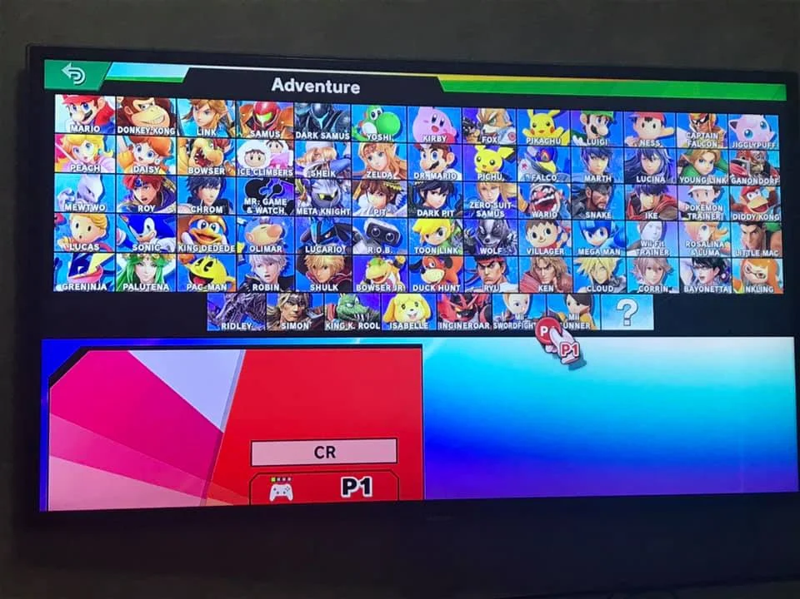
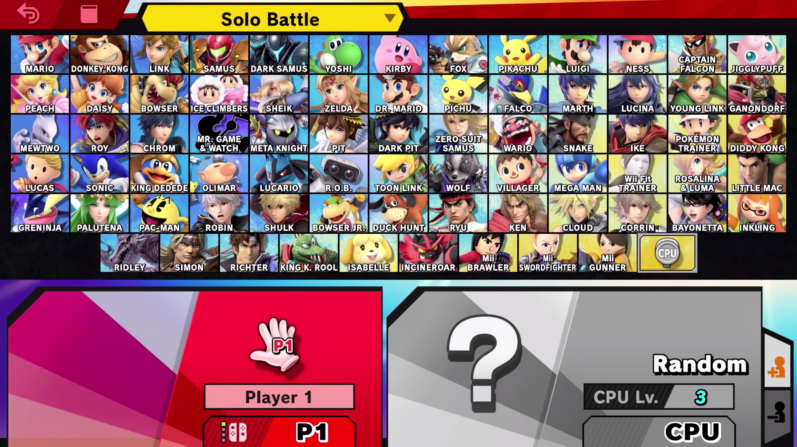
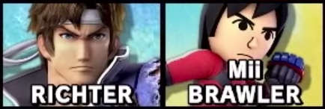
Example – Find Differences in Sets
The user inputs a screenshot of a screen that changes its structure, adding every character’s name/portrait to a partial list A.
The missing characters are identified based on what’s in the complete list but not the partial list, or B – A.
A screenshot of the final roster is added next, which creates the complete list B.
Super Smash Bros. Ultimate (Nintendo Switch)

Slide 21
Part 3:
Bri plays with Tesseract OCR and PyTesseract

Slide 22
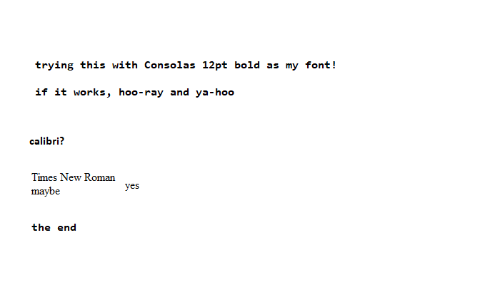
Simple Test with MSPaint and Normal Fonts
trying this with Consolas 12pt bold as my font!
if it works, hoo-ray and ya-hoo
calibri?
Times New Roman
maybe yes.
the end
♀
Raw string text: 'trying this with Consolas 12pt bold as my font!\nif it works, hoo-ray and ya-hoo\ncalibri?\n\nTimes New Roman\n\nmaybe yes.\n\nthe end\n\x0c'

Slide 23
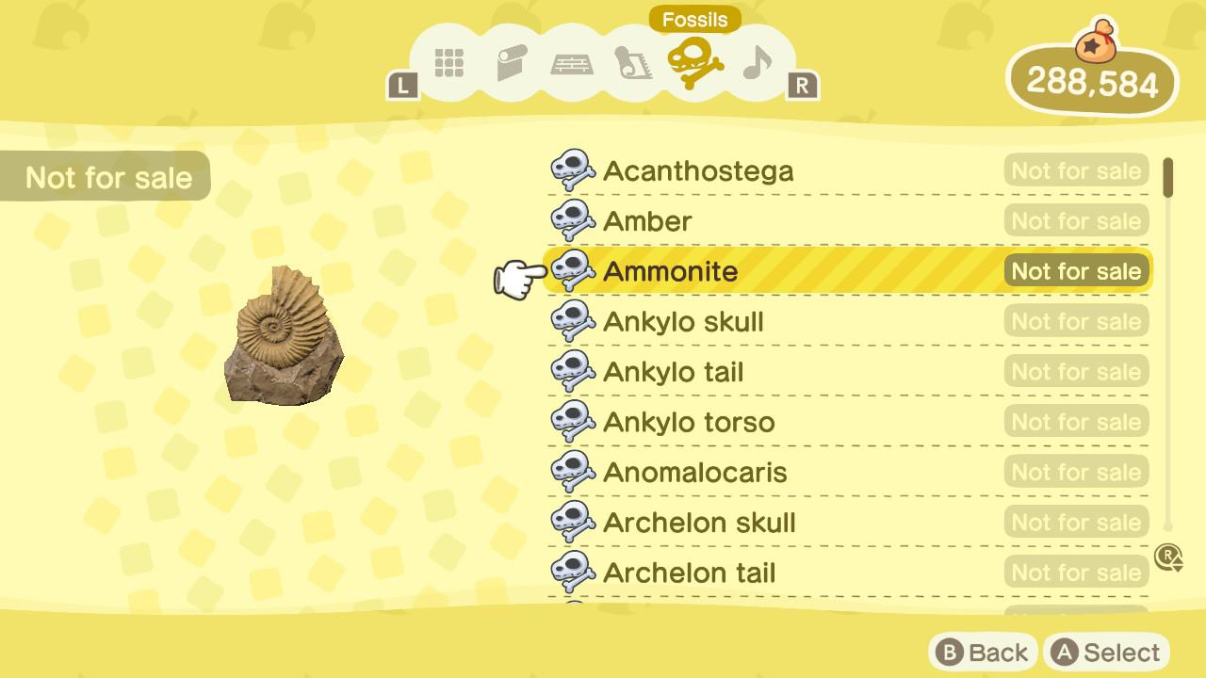
Full Clean Test 1 (Animal Crossing)
ers @YPacanthostesa |
@Back @Select
♀
Raw string text: 'ers @YPacanthostesa |\n\n@Back @Select\n\x0c'

Slide 24
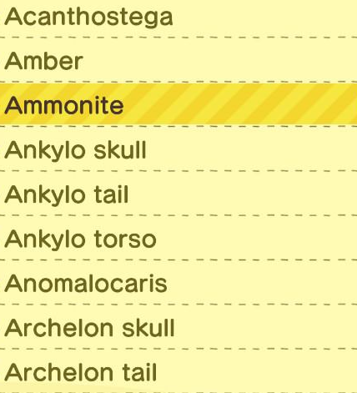
Partial Clean Test 1 (Animal Crossing)
Acanthostega
Archelon tail
♀
Raw string text: 'Acanthostega\n\nArchelon tail\n\x0c'

Slide 25

Single Clean Test 1 (Animal Crossing)
Anomalocaris
♀
Raw string text: 'Anomalocaris\n\x0c'

Slide 26
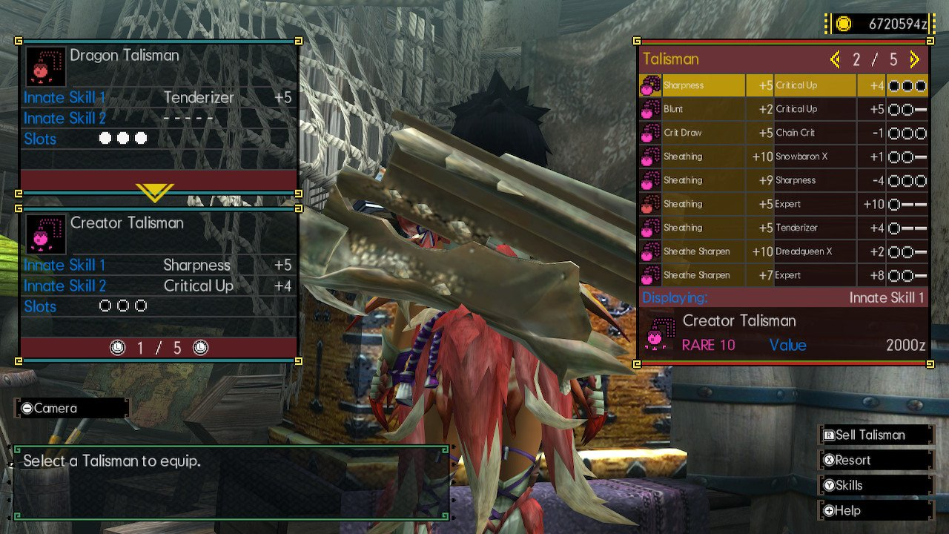
Full Clean Test 2 (Monster Hunter)
cr Pr xerelts
GROW +5 Choin Crit
csr )
Seo Cr! ¥|
Pr) Calin cibd
f : ; : _— a eo
BN
es ig m Pr ue) Bacio
] Creator Talisman Peer Ped
i Ss a eee
—o Skill 1 ii. i +5 a i | oa
ee Skill 2 (et eel he cane 4 Di ra eon p
Slots) ieee aoe
| Creator Talisman
10 Vale 40] 0a
‘&)
@1i1/5@
Eas
‘psel Mere
| oe
ea
[@Help
oa wore TV
♀
Raw string text: ' \n\ncr Pr xerelts\nGROW +5 Choin Crit\n\n \n \n \n \n \n \n \n \n \n \n\ncsr )\nSeo Cr! ¥|\n\n \n\nPr) Calin cibd'+
'\n\n \n \n\n \n\nf : ; : _— a eo\nBN\nes ig m Pr ue) Bacio\n] Creator Talisman Peer Ped\ni Ss a eee\n—o Skill 1 ii. i +5 a i | oa'+
'\nee Skill 2 (et eel he cane 4 Di ra eon p\nSlots) ieee aoe\n| Creator Talisman\n\n \n \n\n10 Vale 40] 0a\n\n‘&)\n\n@1i1/5@\n'+
'Eas\n\n \n \n \n \n\n‘psel Mere\n| oe\nea\n[@Help\n\n \n\noa wore TV\n\x0c'

Slide 27
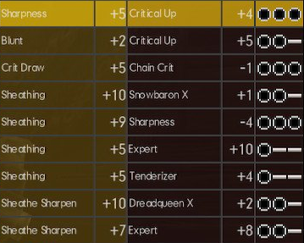
Partial Clean Test 2 (Monster Hunter)
Tg
ert
Sheathing
SE)
Sheathing
Sheathing
Sheathe Sharpen
Sheathe Sharpen
+2 Critical Up
+5 Chain Crit
Baio cig
SSL tak
Sen
Secrets
BUCS
Baie os
be)
a a
Saal
a
al
Br Ot
cele
Ss) ad
♀
Raw string text: 'Tg\n\nert\nSheathing\nSE)\nSheathing\nSheathing\nSheathe Sharpen\nSheathe Sharpen\n\n+2 Critical Up\n+5 Chain Crit\nBaio cig\n'+
'SSL tak\nSen\nSecrets\nBUCS\n\nBaie os\n\nbe)\na a\nSaal\na\nal\nBr Ot\ncele\nSs) ad\n\x0c'

Slide 28
Single Clean Test 2 (Monster Hunter)
Sheathing +10 Srowboron X Saad
♀
Raw string text: 'Sheathing +10 Srowboron X Saad\n\x0c'

Slide 29
Part 4:
Bri tries to see what Tesseract sees

Slide 30
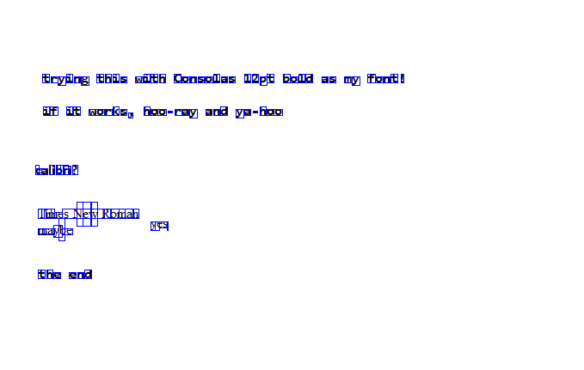
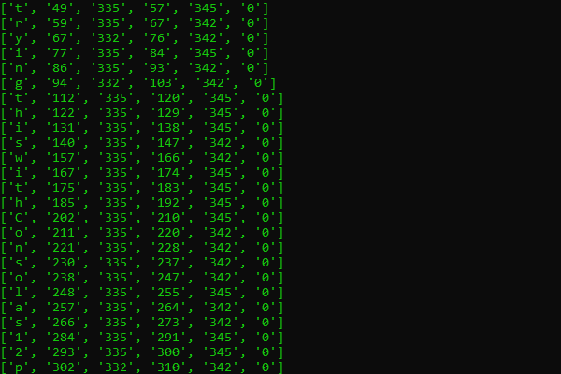
Simple Character Scan
Representation of Character Locations
Data from pytesseract.image_to_boxes()

Slide 31
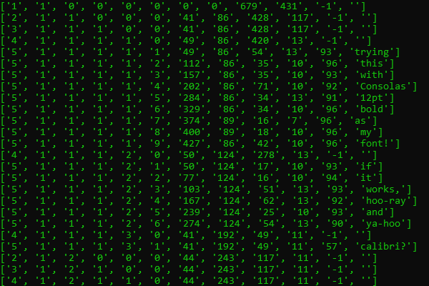
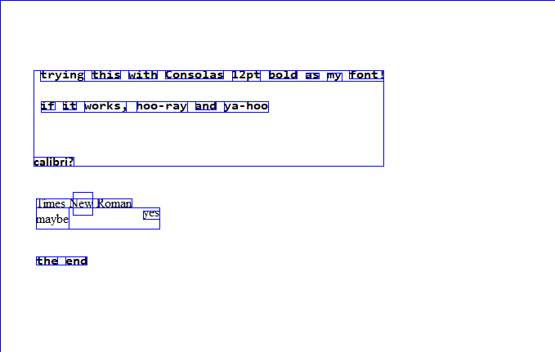
Simple Word Scan
Representation of Word Locations
Data from pytesseract.image_to_data()

Slide 32
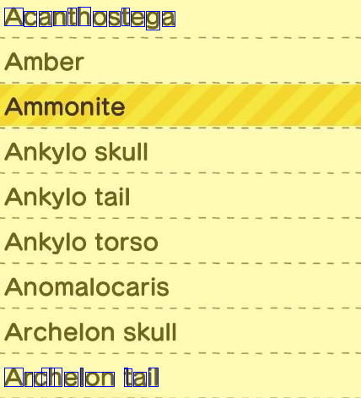
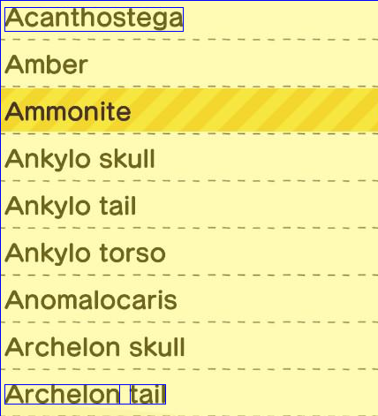
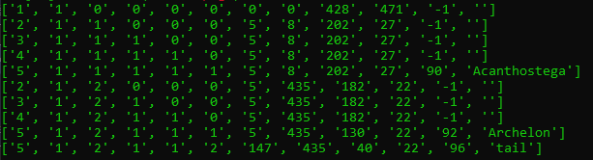
Block Character/Word Scan 1 (ACNH)

Slide 33
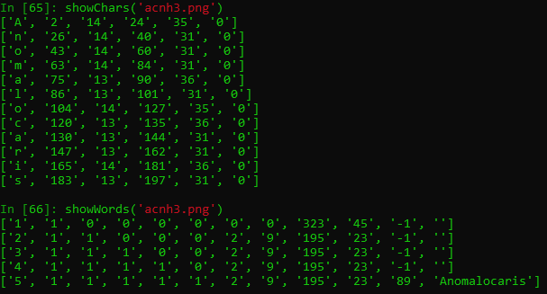


Line Character/Word Scan 1 (ACNH)

Slide 34
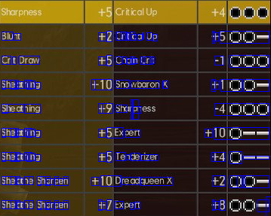
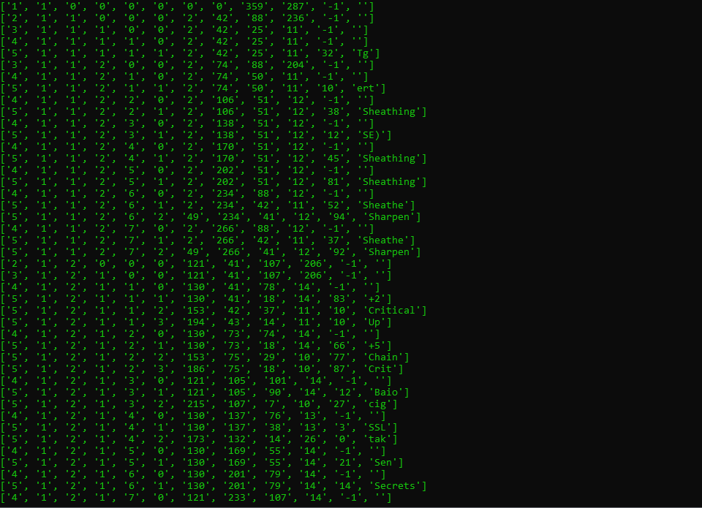
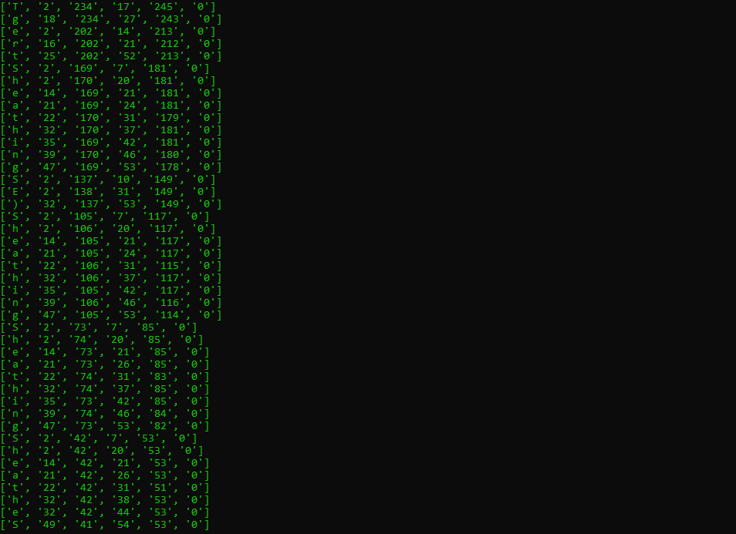
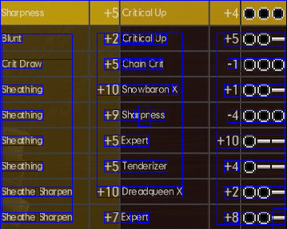
Block Character/Word Scan 2 (MHGU)

Slide 35
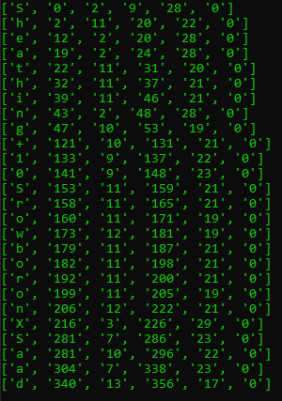
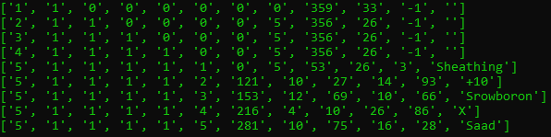
Line Character/Word Scan 2 (MHGU)

Slide 36
Part 5:
Bri reviews image cleaning techniques

Slide 37
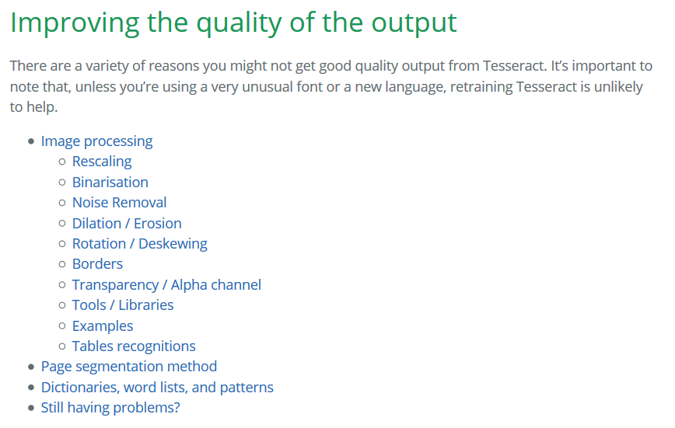
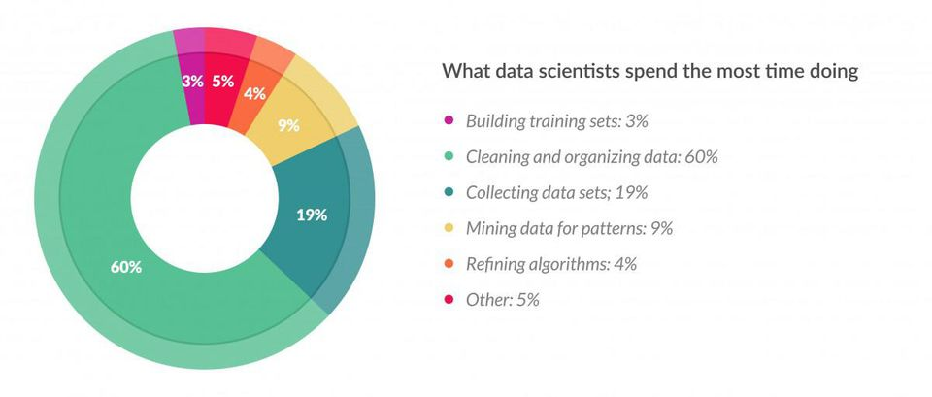
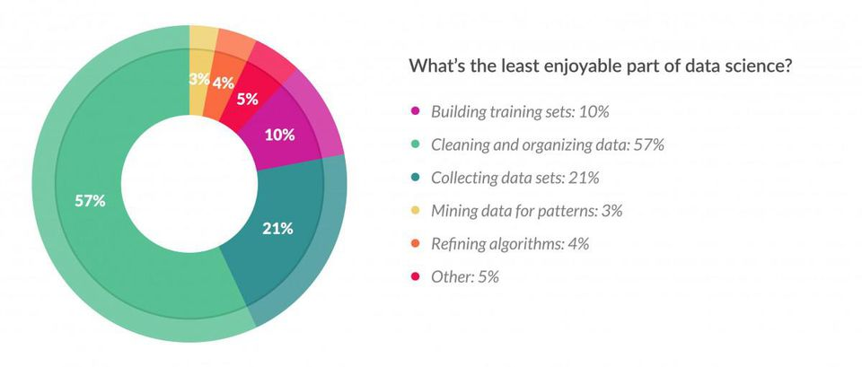
Clean Data is Happy Data

Slide 38
Image Processing Techniques Explored
Inversion: flips color bits – Tesseract prefers dark on light rather than light on dark text
Lazy method: scan once normally, then once inverted
Smart method: if the location of text is known, can simply deduce regional brightness
This doesn’t always improve the result!
'Sheathing +10 Srowboron X Saad\n\x0c'
'Shecthing +10 Srowboron X 410\n\x0c'

Slide 39
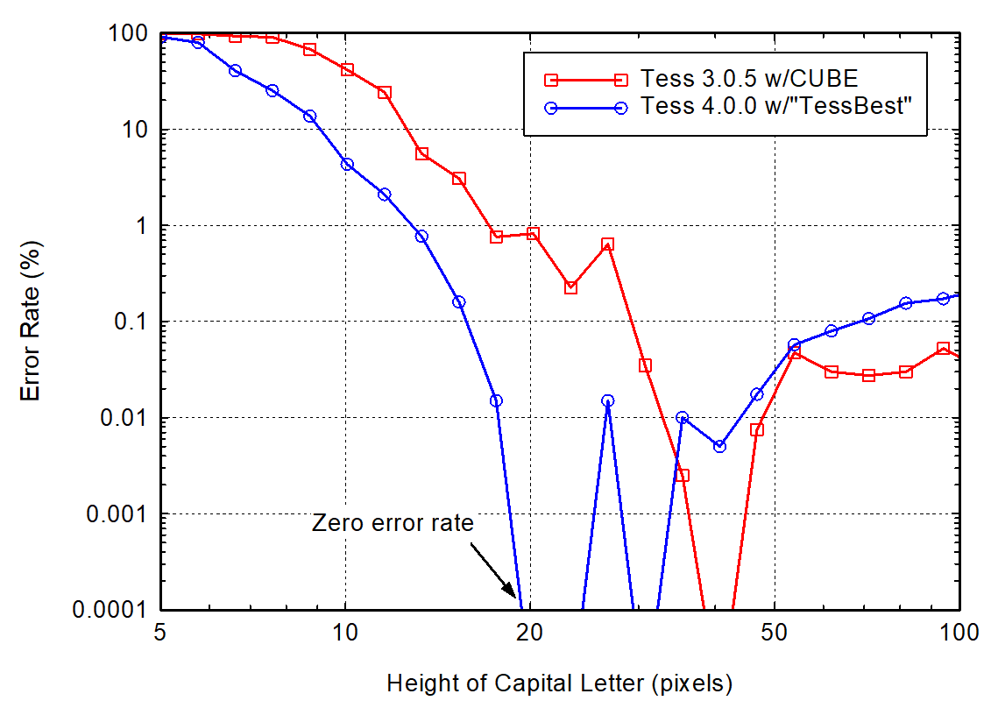
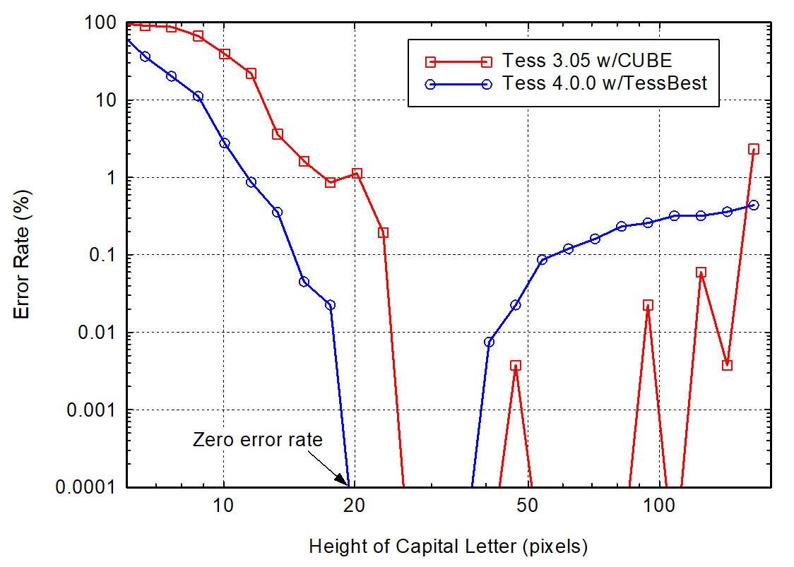
Image Processing Techniques Explored
Rescaling: increases pixels per inch (DPI) – Tesseract works best at 300 DPI
There’s an optimal pixel size range for any font, so we can try the image at different image sizes
Different resize methods may produce different results as well
Can get pixel size based on initial parse, then adjust to optimal sizes for other fonts
Tesseract accuracy for six fonts at pixel height
Tesseract accuracy for four fonts at pixel height

Slide 40
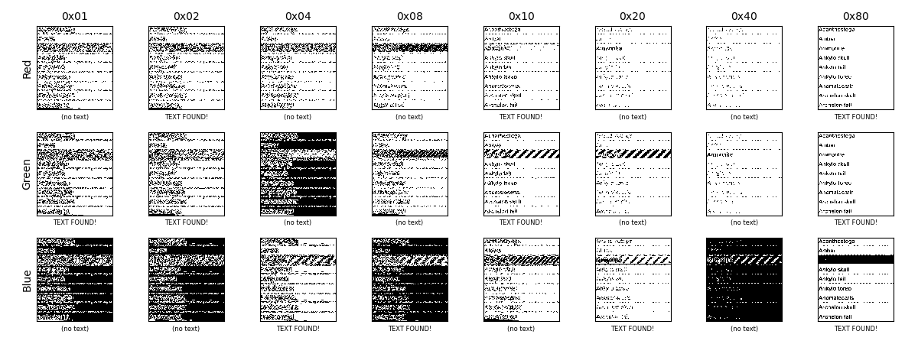
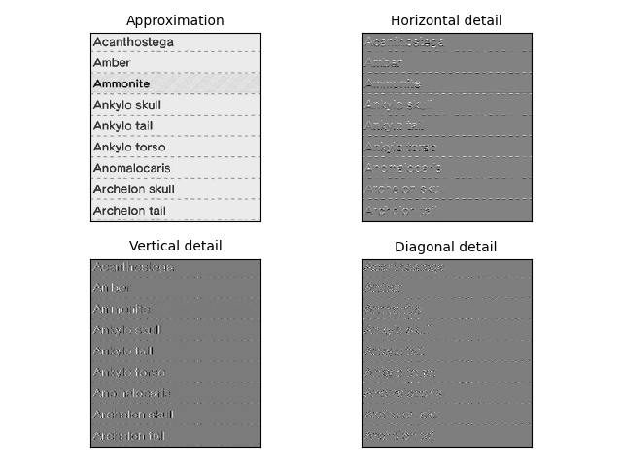
Image Processing Techniques Explored
Binarization: set pixels to black or white based on brightness
Bitplane method: separate image into bitplanes and parse higher end
Discrete wavelet transform method: find edges by adjacent color differences, then fill areas
May also help in recognizing block patterns for text that may be missed

Slide 41
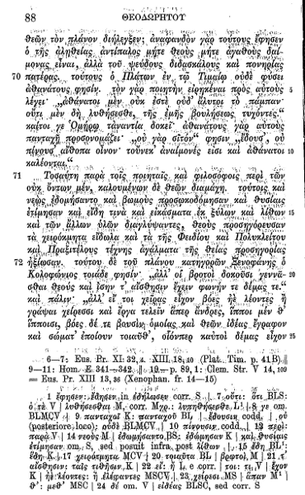
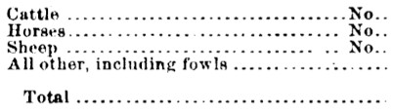

Image Processing Techniques to Try
Noise removal
Noise removal: removes random variations in brightness
Dilation: adds edge pixels to increase visibility of thin characters
Erosion: removes edge pixels for bold characters (e.g. bleeding)
Erosion
Dilation

Slide 42


Image Processing Techniques to Try
Rotation: rotates angled text to be aligned horizontally
Border removal: removes border pixels that may be misinterpreted as characters
Border addition: adds a solid color border to designate text area
Rotation
Border removal
Border addition
Doot doot
Doot doot

Slide 43
Part 6:
Bri plans ahead (kinda)

Slide 44
Future and Optional Tasks
Future tasks:
Experiment with off-screen (camera) images
Implement unused processing techniques
Consider auto-correction for English text
Optional tasks:
Implement picture comparison method in its entirety
Completely abandon this project to work on PDF Read-along program
Rest

Slide 45
(that’s it)

